Slide 2
About EverydayComply
A Solution designed to:
Reduce the risk of your organisation failing to meet the compliance legislation and regulations that impact the business
Identify areas of potential risk before they effect the organisation
Enable management to pin-point areas of the business, teams or individuals where weaknesses or a lack of understanding of compliance responsibilities exist
Build a history of completed assessments to:
Identify patterns where action is needed
Discover areas within your organisation where policies & procedures are lacking or are not being implemented correctly
Seek out trends in poor performing business areas

Slide 3
The Business Requirement
Every organisation is impacted by a variety of Government or industry regulatory bodies
“The term ‘regulation’ generally refers to a set of binding rules issued by a private or public body with the necessary authority to supervise compliance with them and apply sanctions in response to violation of them.”
A few examples include:
- Health & Safety Executive
- Financial Conduct Authority
- Security & Exchange Commission
- Information Commission’s Officer
- Environment Agency
- Not for Profit Organisations etc.
Failure to comply with the ‘rules’ can often result in severe legal punishments, including large fines and in many cases loss of reputation

Slide 4
An organisation will likely have:
- Documented Policies & Procedures it expects its people to adhere to
- Provided induction & training to its people
- No clear understanding that the people within the organisation are complying with the regulations and legislation that impacts it
How can any organisation ensure that the Policy & Procedures they have in place are being adhered to and are understood by its staff?

Slide 5
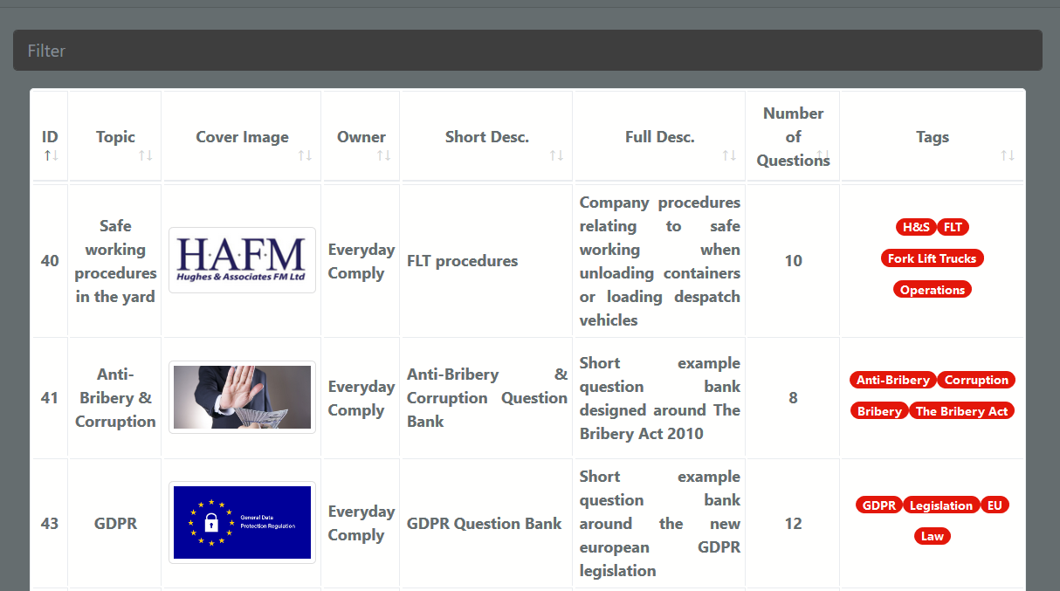
A number of generic or bespoke ‘Question Banks’

Slide 6
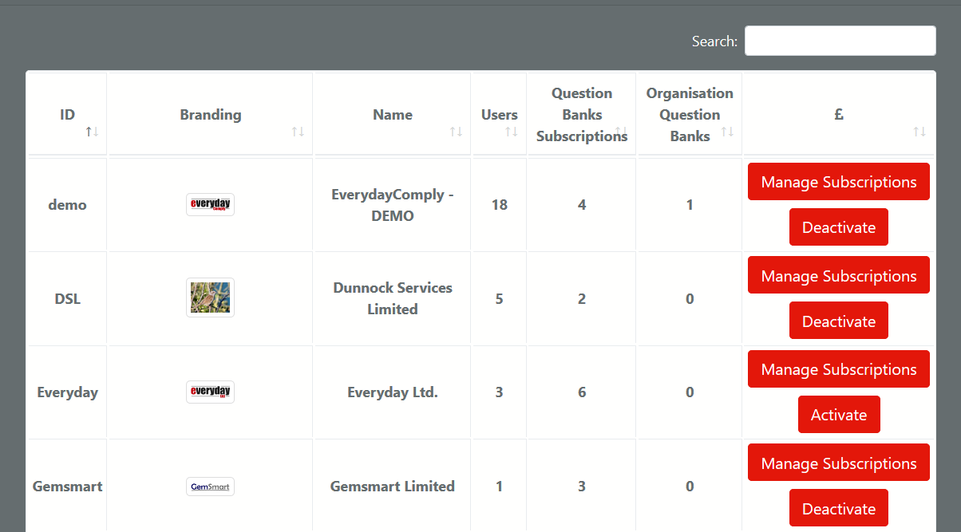
Each “Organisation” has access to either a number of generic or, will usually develop their own, bespoke “Question Banks”

Slide 7
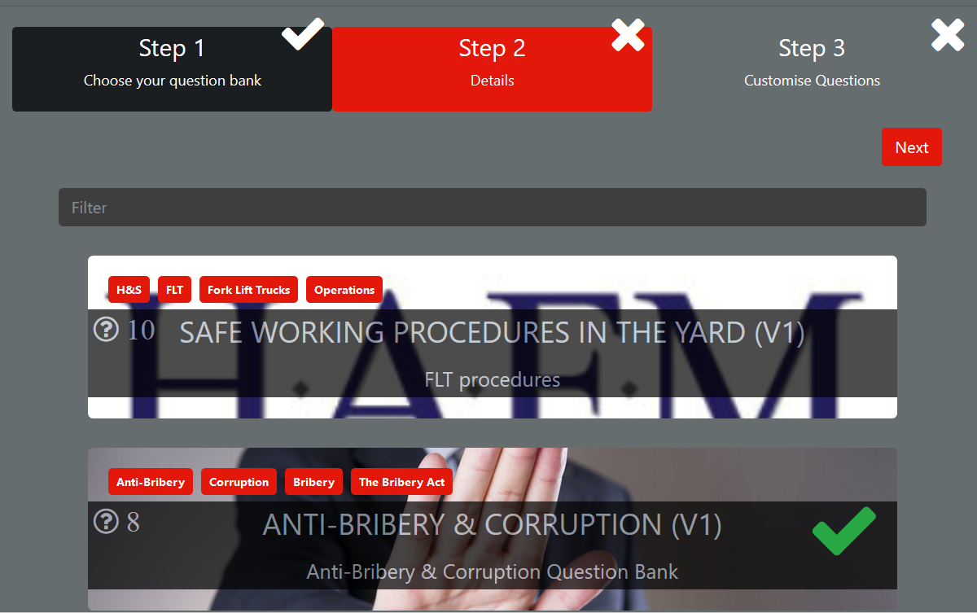

Slide 8
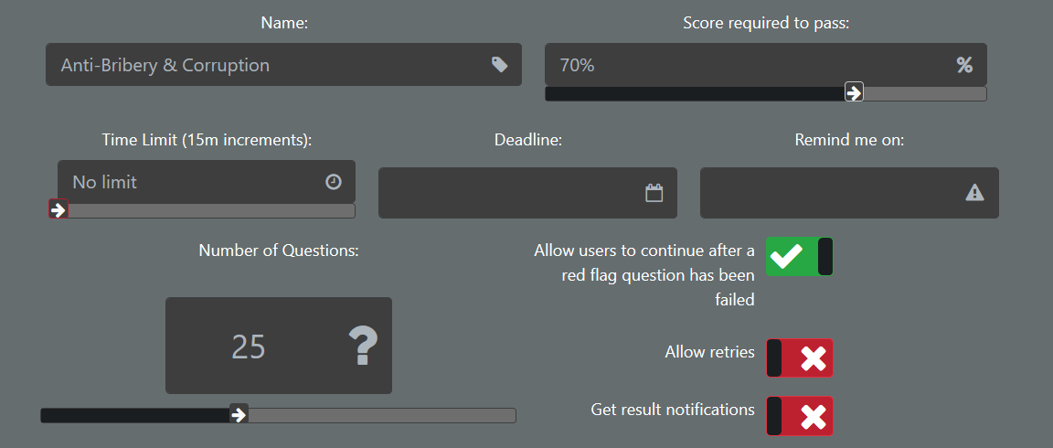

Slide 9
A Group or User will have a number of Assessments assigned for them to complete
- The Organisation Administrator can assign the Assessments to be completed within a particular timeframe or by a specific date
- Questions can be graded, ‘Red Flags’ given to those very important questions that the ‘User’ needs to answer correctly

Slide 10
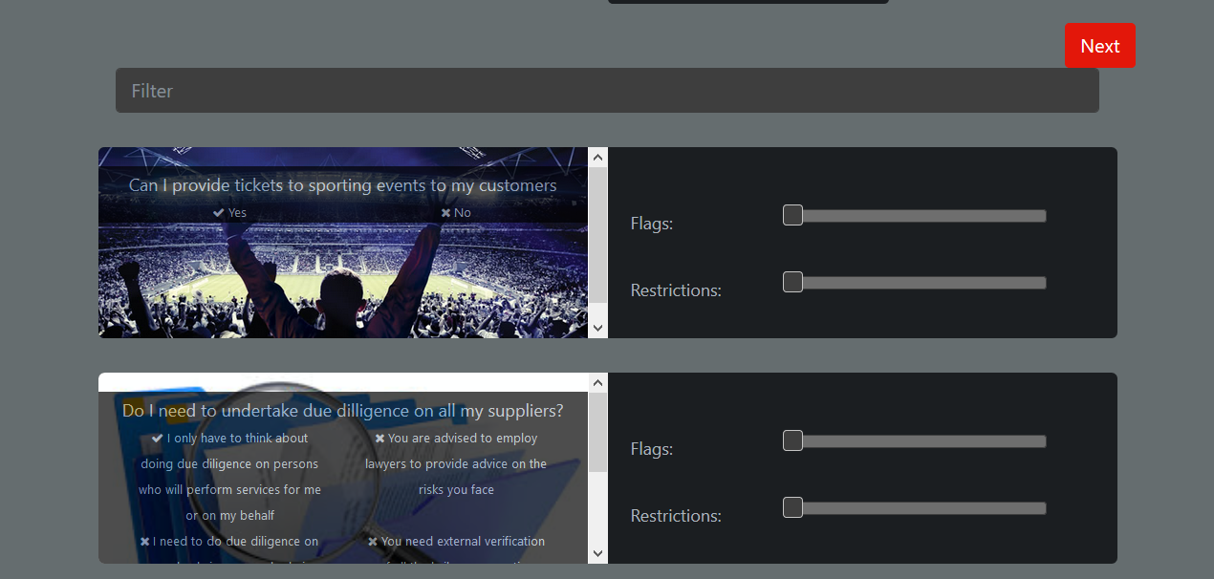

Slide 11
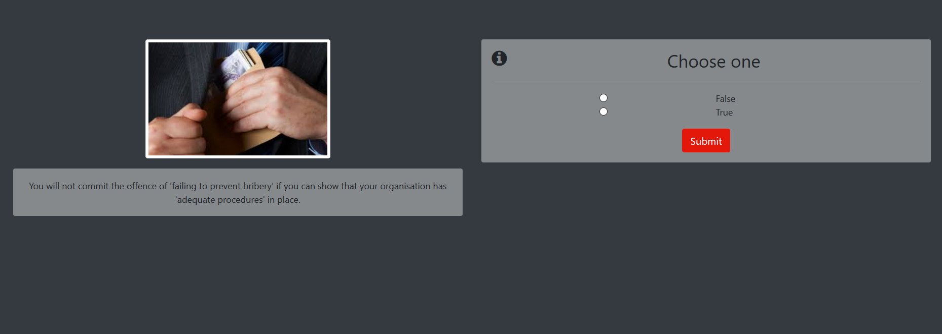
Taking an Assessment

Slide 12
Results are stored for as long as an organisation requires:
- An individual cannot claim to not understand or be unclear about a policy when they have routinely answered a question about the policy correctly a number of times
- Areas where there is confusion or a lack of clarity around a policy can be high- lighted quickly and extra training or remedial action taken
- The quality and effectiveness of any training is clear to management
- Seek patterns of problem areas within a team or by an individual

Slide 13
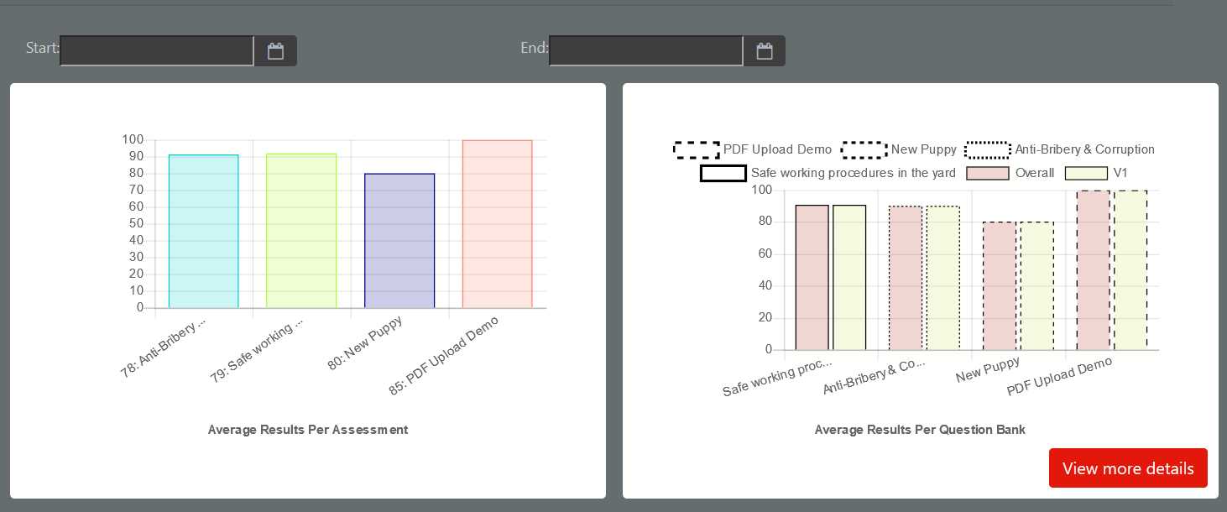

Slide 14
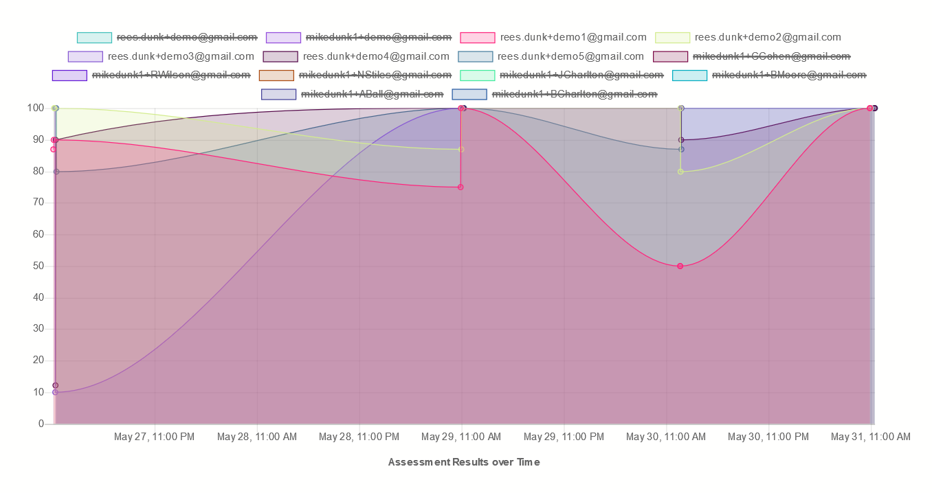

Slide 15
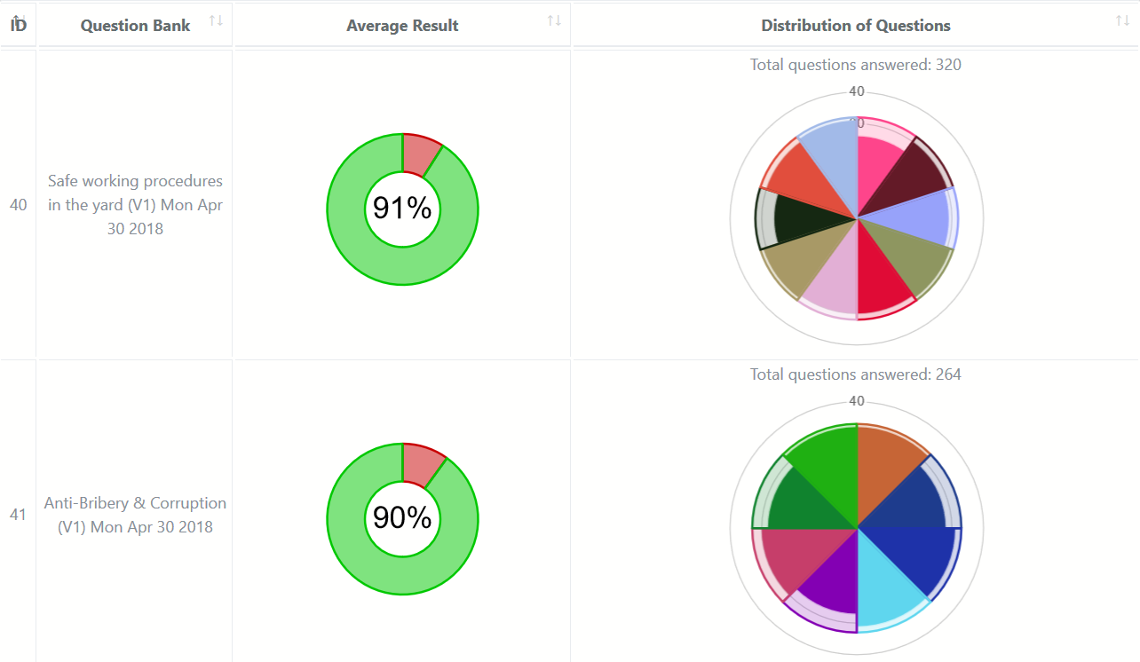

Slide 16
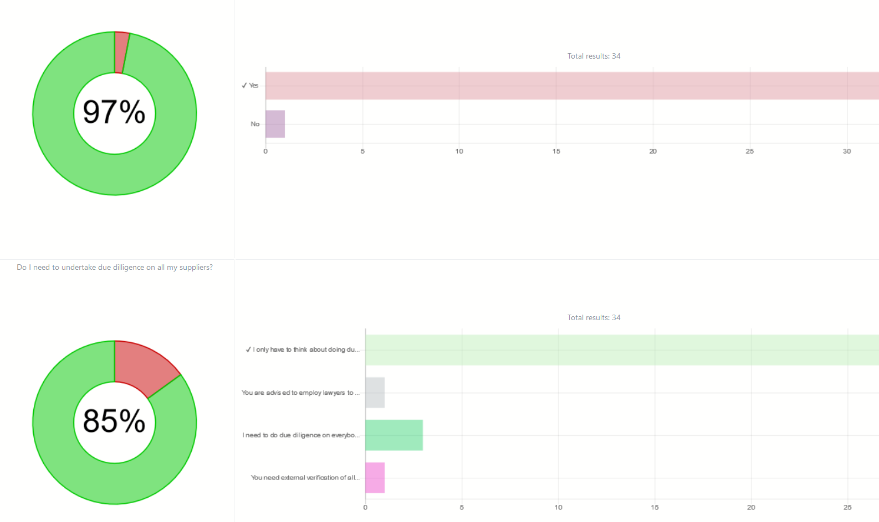

Slide 17
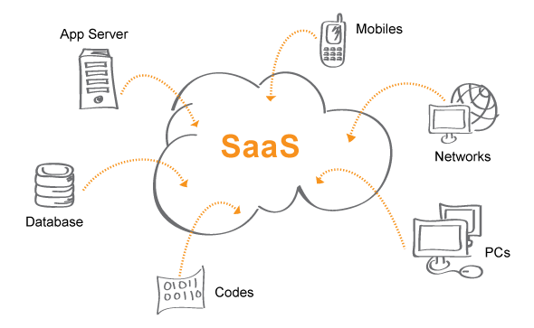
EverydayComply is generally delivered as a SaaS solution (Software as a Service)

Slide 18
EverydayComply helps management at every level of the organisation
Manage Organisational compliance
Reduce risk
Increase business effectiveness
If you would like a demonstration or a discussion on how the solution can support your organisation please contact us on
01245 320370 or E-mail us at info@everydaylimited.com.

